Slide 1
547 Final Project Automatic Product Placement Robot System
Team 11
Yuchao Shen: yuchaosh@usc.edu
Chongbo Zhao chongboz@usc.edu
Jie Zhong: jzhong54@usc.edu

Slide 2
Overview
Motivation
Objectives
Approach
Matlab method
PyBullet method
Result
Conclusion

Slide 3


Motivation
Save the human cost especially in tidy the shelf
Notes:
A mortise (occasionally mortice) and tenon joint connects two pieces of wood or of material. Woodworkers around the world have used it for thousands of years to join pieces of wood, mainly when the adjoining pieces connect at right angles.
Mortise and tenon joints are strong and stable joints that can be used in many projects. The mortise and tenon joint is considered to be one of the strongest joints next to the common dovetail joint.[citation needed] They furnish a strong outcome and connect by either gluing or locking into place. The mortise and tenon joint also gives an attractive lookout. One drawback to this joint is the difficulty in making it due to the precise and tight cutting required. In its most basic form, a mortise and tenon joint is both simple and strong. There are many variations of this type of joint, but the basic mortise and tenon has two components:
the mortise hole, and
the tenon tongue.
The tenon, formed on the end of a member generally referred to as a rail, fits into a square or rectangular hole cut into the other, corresponding member. The tenon is cut to fit the mortise hole exactly. It usually has shoulders that seat when the joint fully enters the mortise hole. The joint may be glued, pinned, or wedged to lock it in place.

Slide 4
Objectives
Type 1: Single arm movement
Type 2: Dual-arm Collaboration
Type 3: Dual- arm event system
Notes:
A mortise (occasionally mortice) and tenon joint connects two pieces of wood or of material. Woodworkers around the world have used it for thousands of years to join pieces of wood, mainly when the adjoining pieces connect at right angles.
Mortise and tenon joints are strong and stable joints that can be used in many projects. The mortise and tenon joint is considered to be one of the strongest joints next to the common dovetail joint.[citation needed] They furnish a strong outcome and connect by either gluing or locking into place. The mortise and tenon joint also gives an attractive lookout. One drawback to this joint is the difficulty in making it due to the precise and tight cutting required. In its most basic form, a mortise and tenon joint is both simple and strong. There are many variations of this type of joint, but the basic mortise and tenon has two components:
the mortise hole, and
the tenon tongue.
The tenon, formed on the end of a member generally referred to as a rail, fits into a square or rectangular hole cut into the other, corresponding member. The tenon is cut to fit the mortise hole exactly. It usually has shoulders that seat when the joint fully enters the mortise hole. The joint may be glued, pinned, or wedged to lock it in place.

Slide 5
Approach
Matlab method
PyBullet method

Slide 6
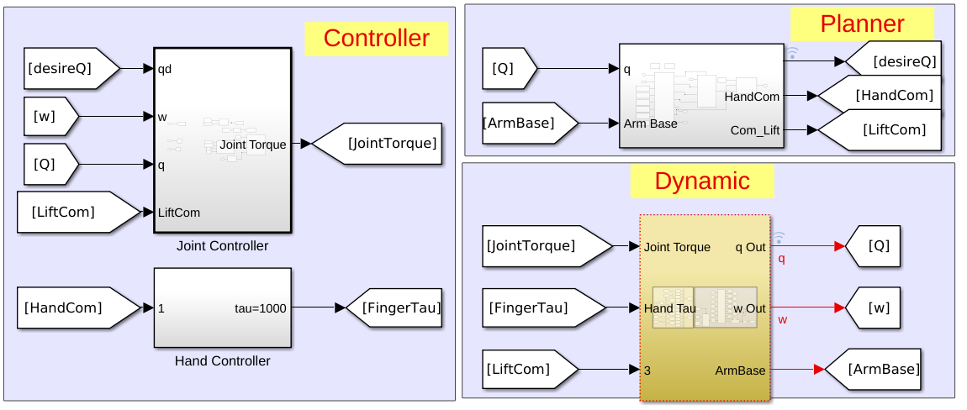
Matlab method
Concentrate more on the dynamic and control.

Slide 7
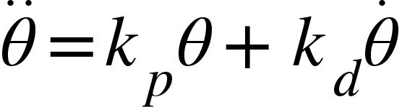
Matlab method
-Controller:
-Planner ： - RRT (main)
- Inverse Kinematic & Linear
- None

Slide 8
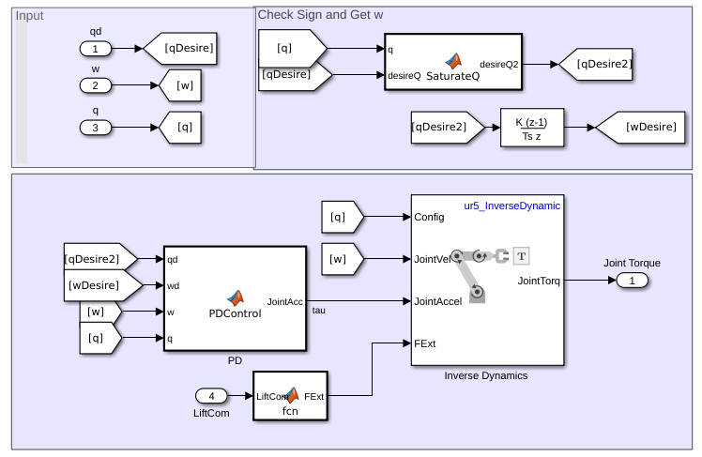
-Controller:

Slide 9
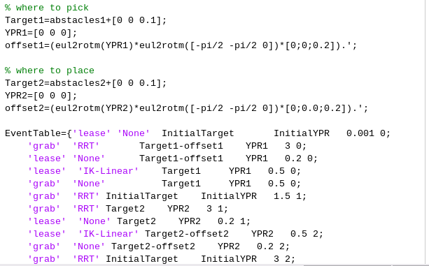
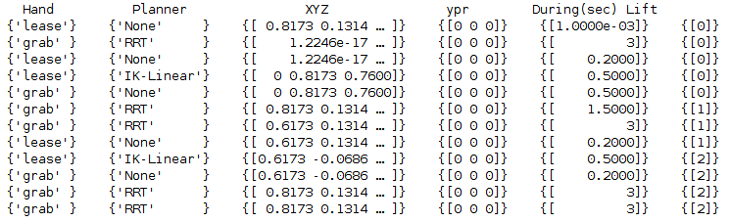
-Planner:
Event->Actions -> Command

Slide 10
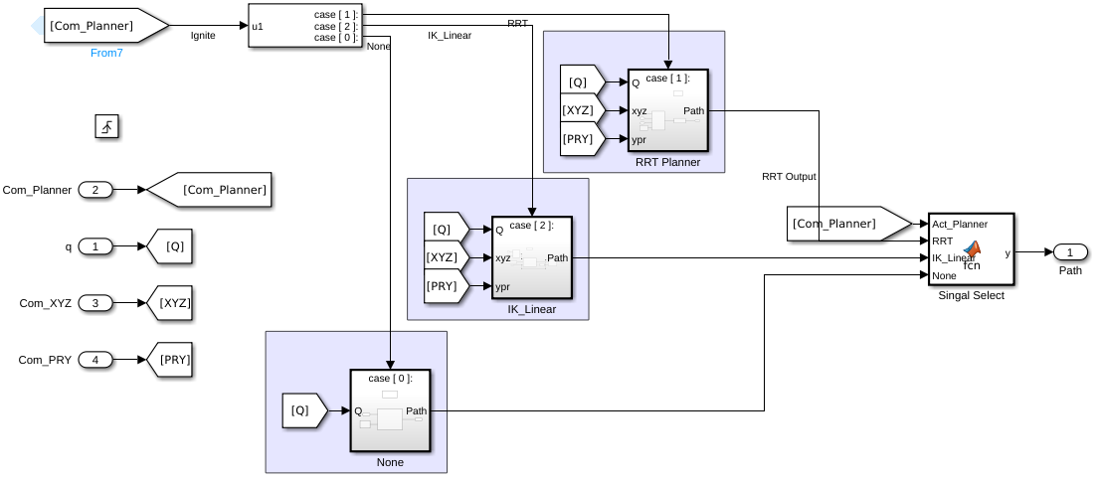
-Planner Selector:

Slide 11
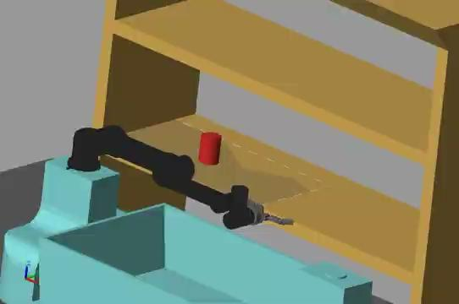
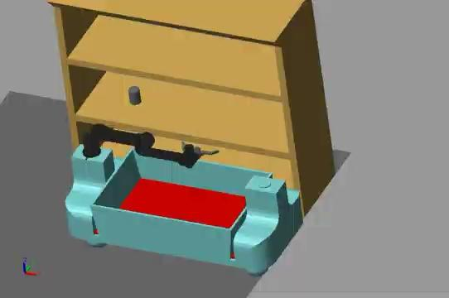
-Demo01

Slide 12
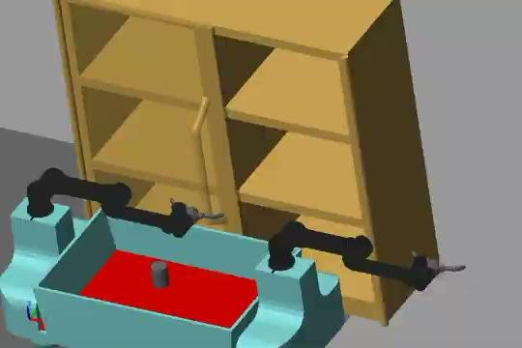

Slide 13
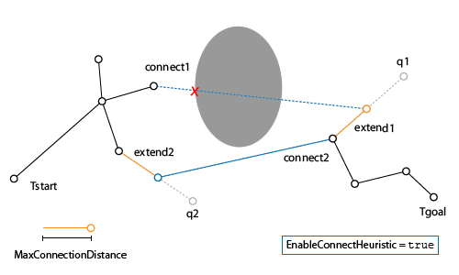

Slide 14
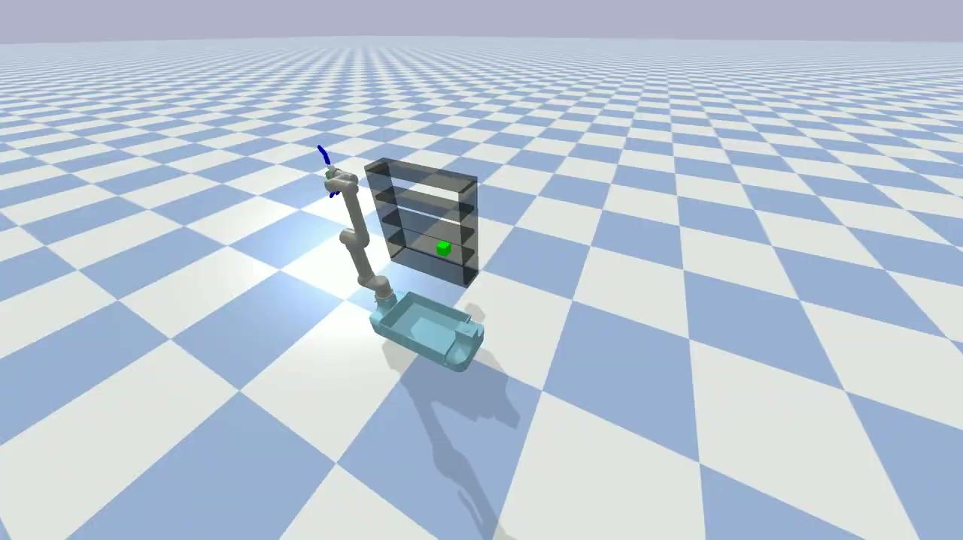
PyBullet method
single arm planing: Bi-RRT

Slide 15
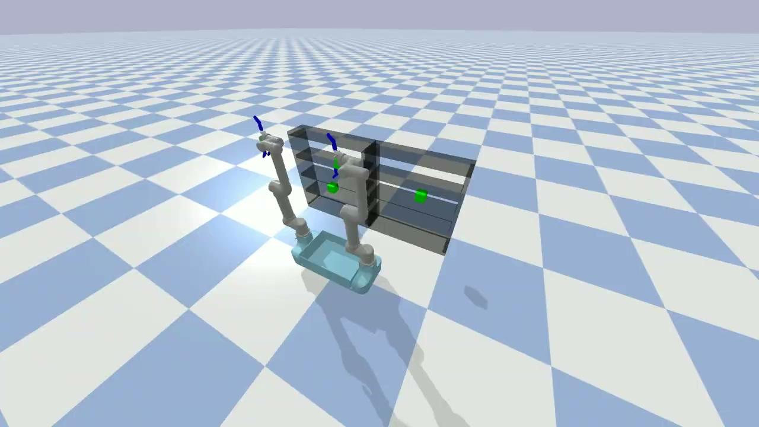
PyBullet method
Dual-arm collaboration planing: fast-Bi-RRT

Slide 16

PyBullet method
Dual-arm collaboration planing: fast-Bi-RRT

Slide 17
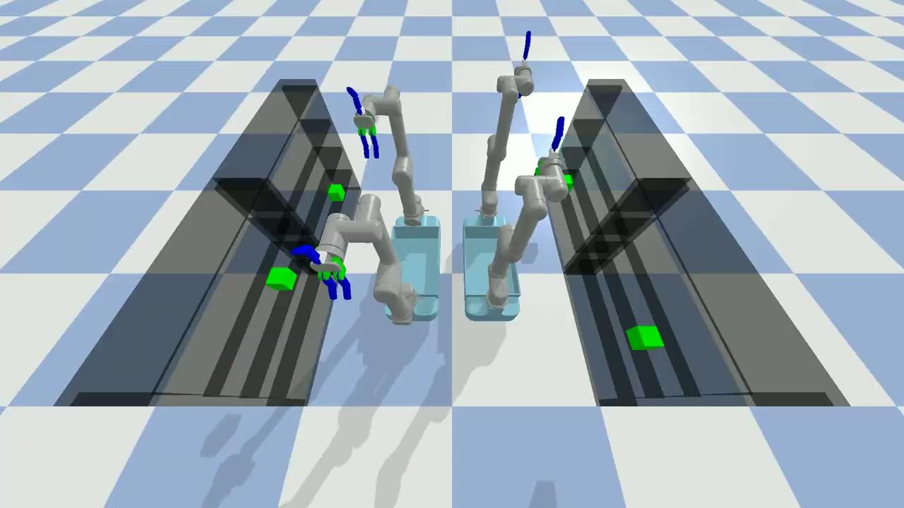
PyBullet method
2+ arm collaboration planing: fast-Bi-RRT

Slide 18
PyBullet method
block diagram of fast-Bi-RRT
single arm bi-RRT
conduct interpolation
collision detection between two robot arm’s paths
Conduct bi-RRT again in those path range
get the path range that has collision

Slide 19
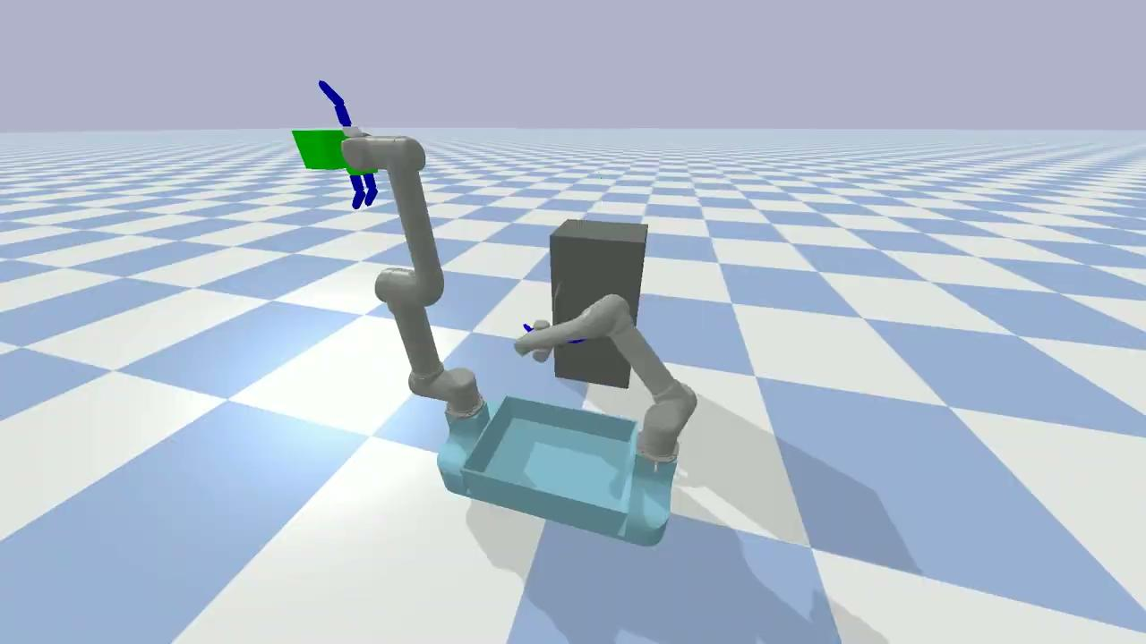
PyBullet method
dual-robot event system

Slide 20
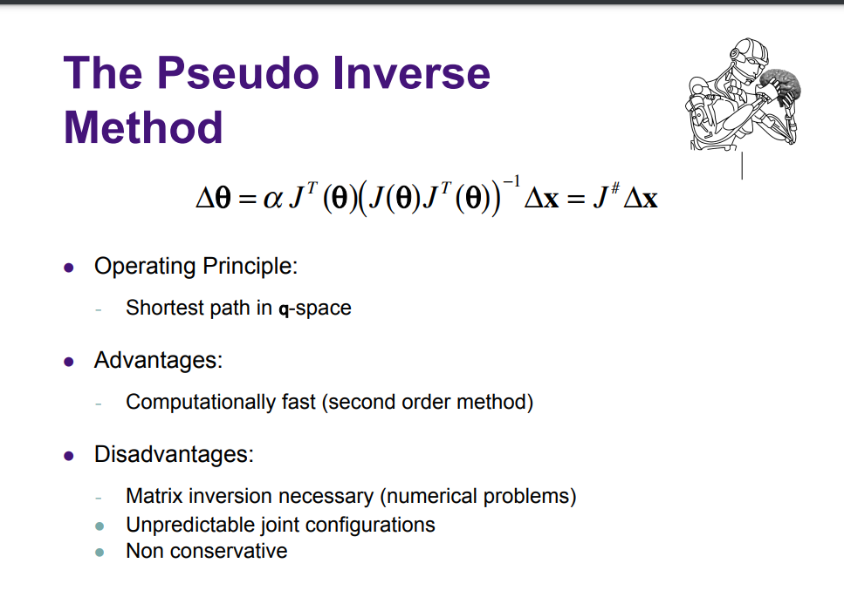
PyBullet method
dual-robot event system

Slide 21
PyBullet method
Why we need to use faster Bi-RRT:
Easier
Faster

Slide 22
Contribution
Yuchao Shen:
simulation environment construction; IK analytic solution; basic RRT
Chongbo Zhao:
Matlab controller and planer design; simscape construction
Jie Zhong:
PyBullet planning algorithm design; fast-Bi-RRT

Slide 23
Conclusion
result
future

Slide 24
Q&A

